Slide 1
Control Structures

Slide 2
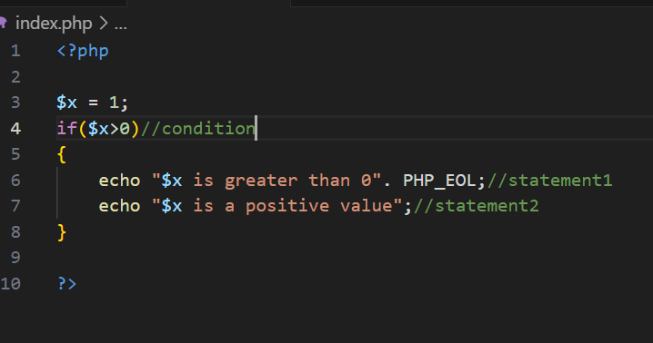
Statement Blocks
Statement: A statement is a sentence or expression that is true or carry on an action in programming.
Statement Blocks: In PHP, A block statement refers to a group of statements enclosed within curly braces {}. These statements are executed together as a block. Block statements are typically used in control structures like if, for and functions.

Slide 3
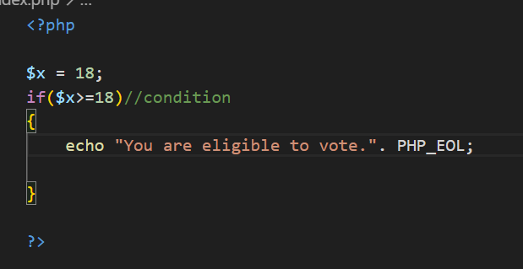
IF Construct
In PHP, the if construct is a control structure used to execute a block of code only if a specified condition is true. It allows the program to make decisions based on certain conditions.

Slide 4
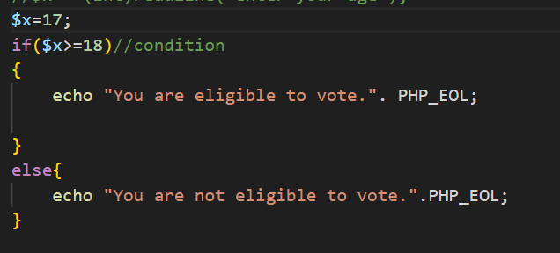
Else keyword
The else keyword in PHP is used with the if construct to define an alternative block of code that will execute if the condition in the if statement is false. Essentially, it provides a fallback option when the if condition is not met.

Slide 5
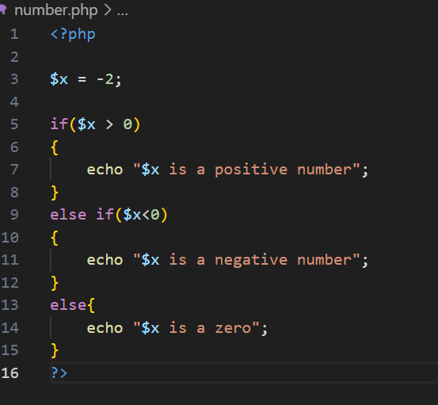
Else If keyword
In PHP, the else if keyword is used in combination with the if construct to check multiple conditions in a sequence.
If the if condition is false, it checks the else if condition. You can use multiple else if statements to create a chain of conditions, and if all conditions are false, an optional else block can execute a default action.

Slide 6
Looping Constructs
In PHP, loop constructs allow you to repeatedly execute a block of code as long as a specific condition is met.
There are 4 types of loop constructs:
While loop
Do while loop
For loop
Foreach loop

Slide 7
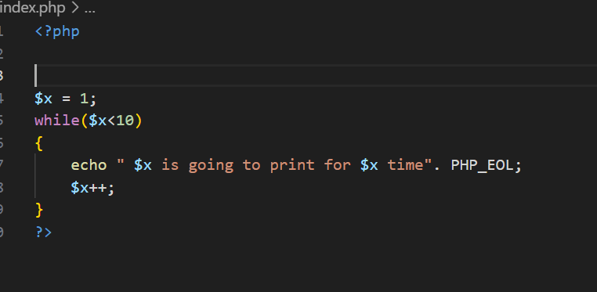
While Loop
A while loop in PHP is used to repeatedly execute a block of code as long as a specified condition is true.
The condition is evaluated before each iteration, and if it returns true, the loop continues. If the condition becomes false, the loop stops.

Slide 8
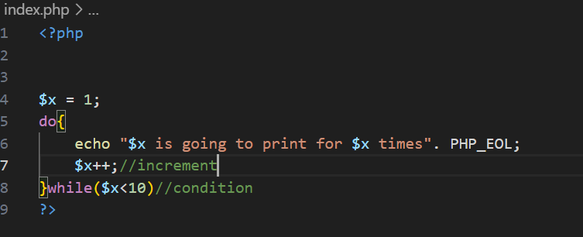
Do-while Loop
A do-while loop in PHP is a type of control structure that repeatedly executes a block of code as long as a specified condition is true.
The key difference between a do-while loop and a while loop is that the do-while loop guarantees that the code block will execute at least once, even if the condition is false from the start. This is because the condition is checked after the code block has been executed.

Slide 9
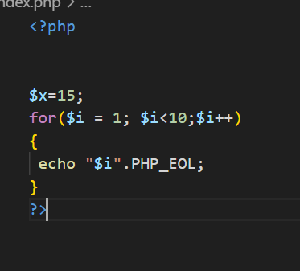
For Loop
A for loop in PHP is used to repeatedly execute a block of code a specific number of times. It is commonly used when you know in advance how many times you want to run the loop.
Structure: for (initialization; condition; increment/decrement) {
// Code to be executed
}

Slide 10
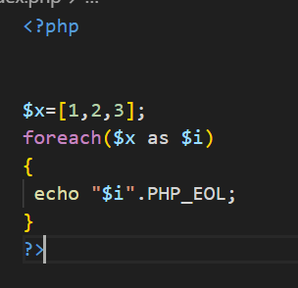
Foreach Loop
A foreach loop in PHP is used to iterate over arrays or objects. It allows you to loop through each element of an array or object without needing to know how many elements there are. The foreach loop is simple and efficient for working with array data.
Structure: foreach ($array as $value) {
// Code to be executed for each value in the array
}

Slide 11
Loop control words
Loop control words in PHP are special keywords that control the flow of loops such as for, foreach, while, and do-while. These control words help you manage the behavior of loops by either skipping iterations or stopping the loop altogether.
The three main loop control words in PHP are:
Break
Continue
Exit or die

Slide 12
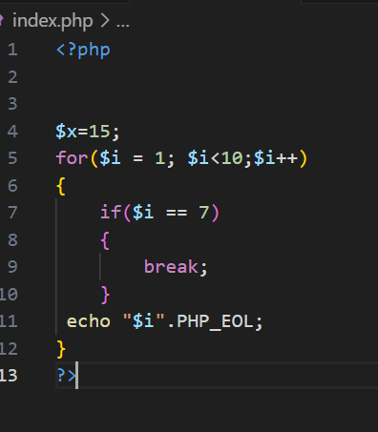
Break
The break keyword is used to exit the loop immediately. It terminates the loop, and the script continues execution after the loop.

Slide 13
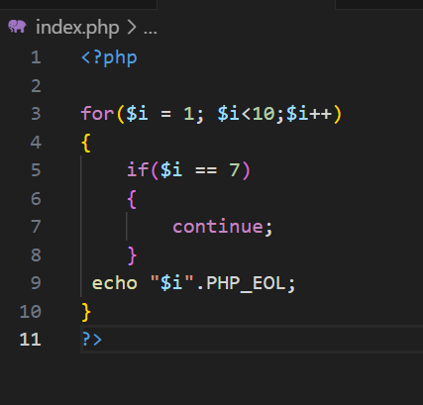
Continue
The continue keyword skips the current iteration of the loop and moves on to the next one.

Slide 14
Thank you

